Slide 1
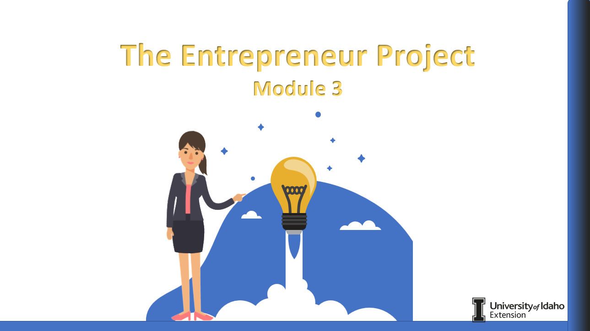

Script:
Welcome to Module 3 of the Entrepreneur Project. I will be your guide throughout this module. You will navigate by using the arrows you will find on each side of the screen which will advance to the next slide or review the previous slide. Make sure to take advantage of the notepad provided to make notes about your business venture. Let’s get started!
Screen Text: The Entrepreneur Project Module 3
Buttons: Standard Navigation Bar
Fonts: Arial
Video/Images: Animated Narrator

Slide 2
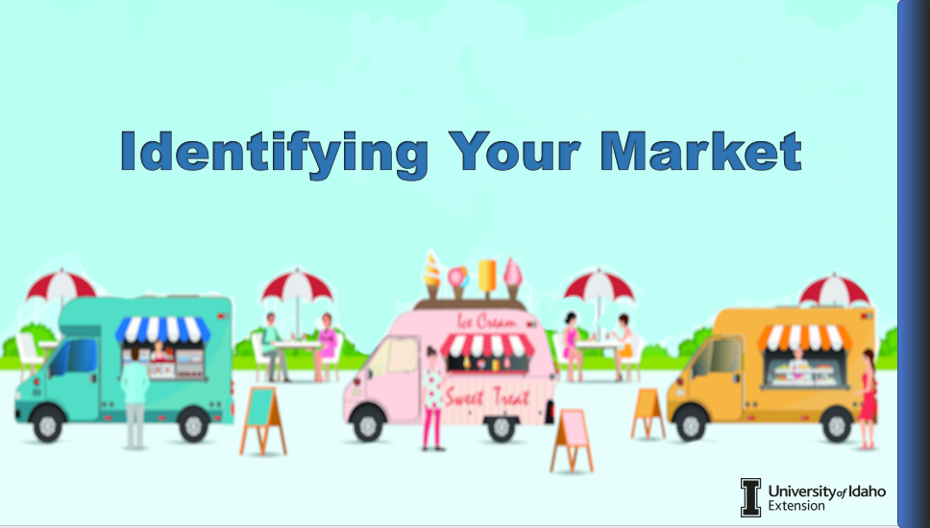
Introduction
Script:
First let’s identify the market that is being targeted by our entrepreneurs. All businesses have a specific market and identifying who the customers are is key to operating a successful business.
Screen Text: Identifying Your Market
Buttons: Standard Navigation
Fonts: Arial
Video/Images:

Slide 3
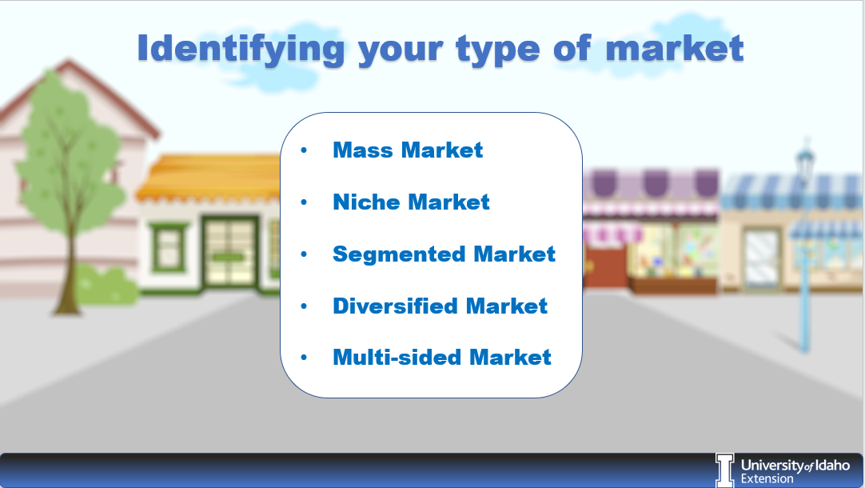
Types of Markets
Script: There many different types of markets.
The mass market targets everyone and doesn’t distinguish between groups of people. Your ability to compete is dependent on the price of your product.
The niche market provides products for a specific environment only. An example of this would be selling a health-conscious product within a health store.
The segmented market identifies customers through slightly different needs and problems. For example, credit card companies may provide the mass market with credit card offers, yet the credit limit each person receives is different.
The diversified market serves two or more unrelated groups of people.
Finally the multi-sided market provides products or services to two or more customer groups who are related to each other.
Your customers will fall into one of these groups.
Screen Text: Identifying your type of market
Mass Market
Niche Market
Segmented Market
Diversified Market
Multi-sided Market
Buttons: Standard Navigation
Fonts: Arial
Video / Images: Animated Narrator

Slide 4
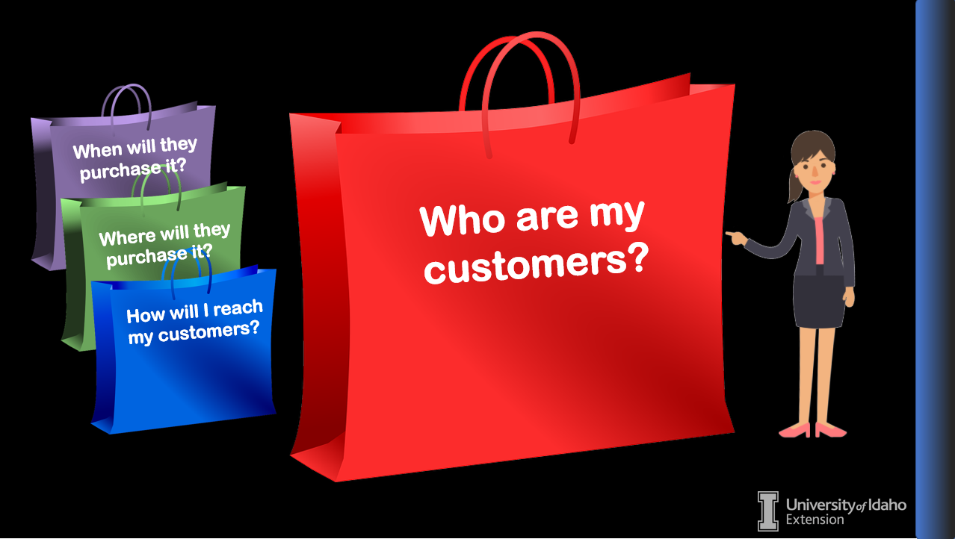
Who are my customers?
Script:
Who are my customers? Ask yourself, is your product one that will fill the needs of a variety of people or is it specific to a select few? Is your product so expensive so that it can only be afforded by a few, or suitable and affordable for everyone? These types of questions will help you define your market and assist you in targeting your customers.
Let’s look at Susan’s business idea.
Screen Text:
Buttons: Standard Navigation
Fonts: Arial
Video / Images: Animated Narrator

Slide 5
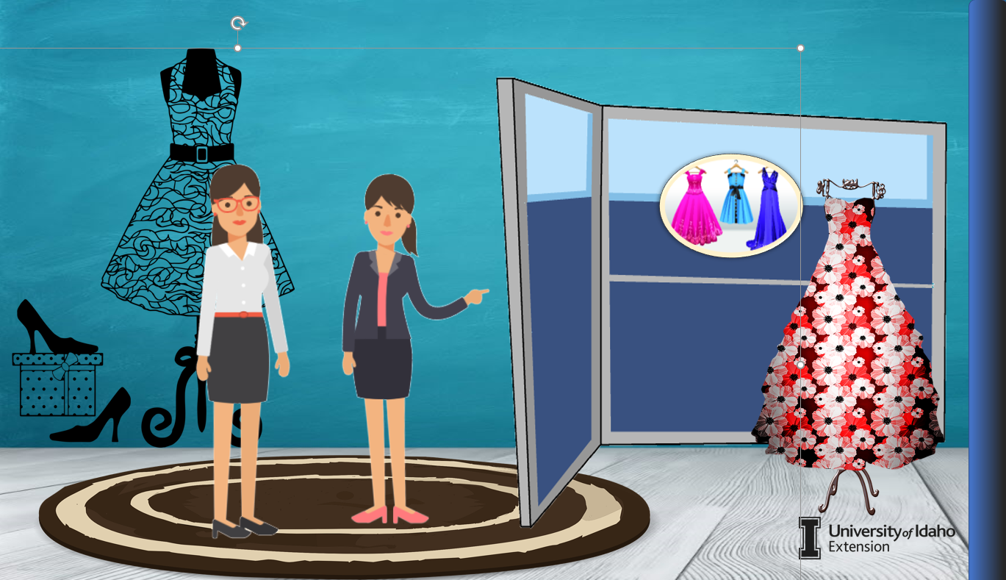
Susan’s Business
Script:
“Hi Susan. How is your business plan coming along?”
“I am learning how to identify and target my customer base. Initially, I was only making dresses for Quinceañeras, but I decided that I was limiting my clientele. Now I am expanding to include formal dresses for all occasions. I plan on continuing to work as a seamstress as well. I will provide alteration service for both men’s and women’s clothing.”
“That sounds like a great idea! By providing your services as a seamstress to both men and women you have doubled your number of potential customers and increased the size of your market!“
Who are Susan’s customers? Initially Susan’s customers were just individuals who were seeking Quinceañera dresses. However, Susan decided that she could gain more customers by providing formal wear for men and women. She also added in additional customers who need alterations and repairs to clothing.
Screen Text:
Buttons: Standard Navigation
Fonts: Arial
Video/Images: Animated Narrator and Susan
Notes:
Script: NEEDED

Slide 6
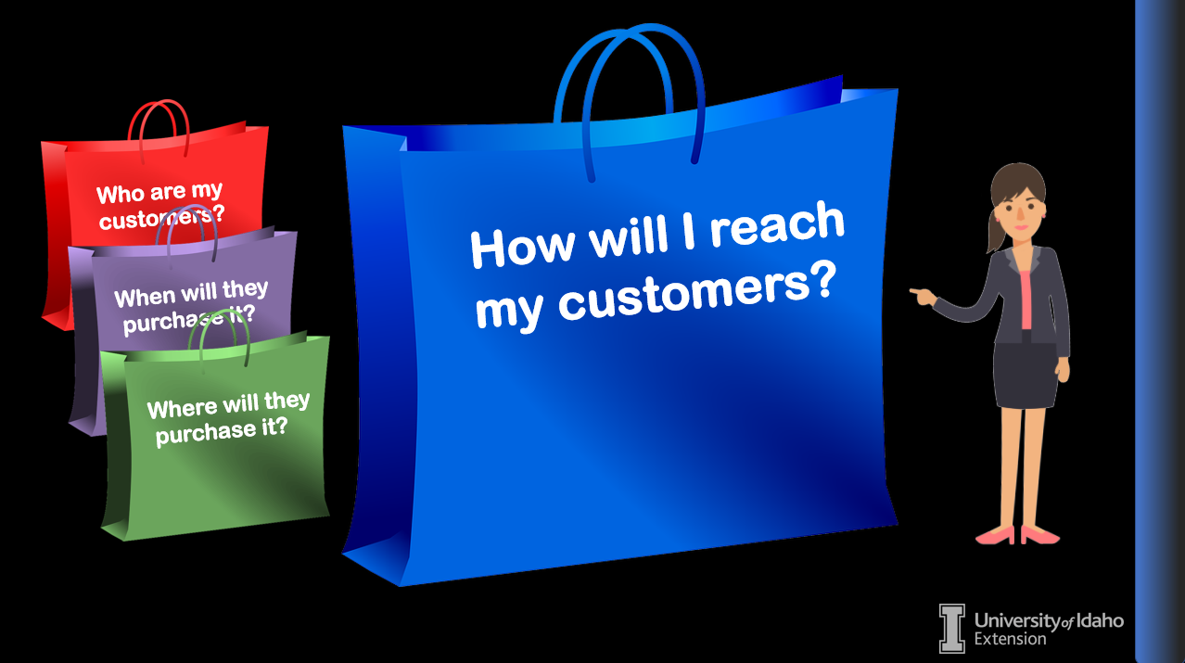
How will I reach my customers?
Script:
To identify your market you should consider how the customer will see or hear about your business. Will it be at the doctor’s office, coffee shop or on the street? If most of your customers read the newspaper you could advertise there. Many businesses use social media to reach their target market inexpensively.
Screen Text:
Buttons: Standard Navigation Bar
Fonts: Arial
Video / Images: Animated Narrator

Slide 7

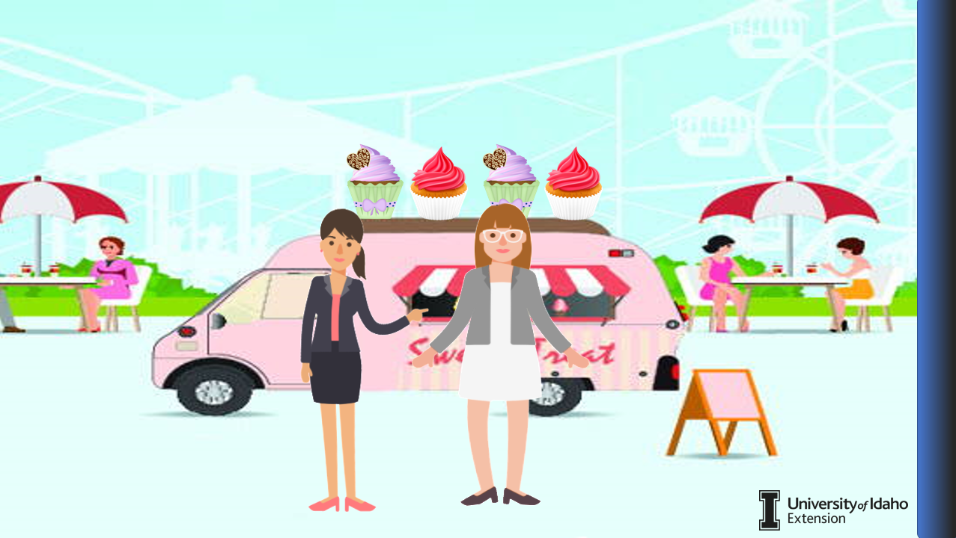


Victoria’s Business
Script:
Let’s check in with Victoria and talk about the progress she is making with her business.
“Hi Vicky! How is your business going?”
“Hey! I have been working on increasing my market. Currently I bake items for friends and family and am trying to build a successful catering business. I go to the local farmer’s market to try out new gluten free and Keto cookie ideas. I have also contacted a few coffee shops in town who are going to purchase a dozen cookies a week to sell. The feedback has assisted me in building a new bakery menu. It is a small start but am trying to build a following and get my business name out there. ”
“I think those are great ideas to help you identify, build and target your market within your community.”
How will customers hear about Vicky’s business? Vicky is meeting her customers at the local farmer’s market and at the coffee shops. Not only are they hearing about her business, but they are also sampling the merchandise.
New Menu
Screen Text:
Buttons: Standard Navigation
Fonts: Arial
Video/Images: Animated Narrator and Victoria
Notes:
Script: NEEDED

Slide 8
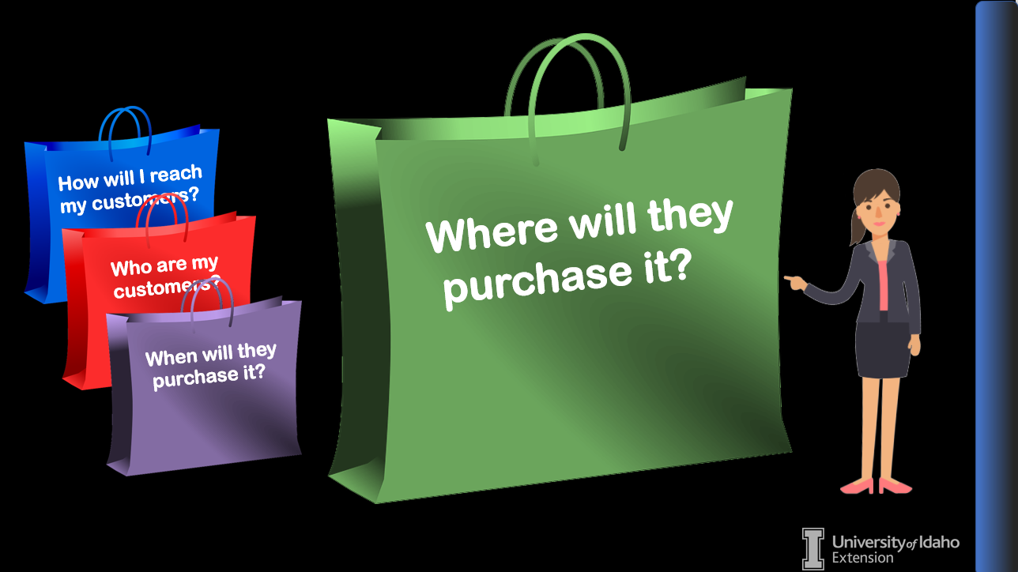
Where will they buy it?
Script: Where will customers buy the product or service? Products and services can be sold in several different ways. For instance handcrafted items can be sold at craft shows, flea markets, boutiques or other retailers. Many products and services are sold from home offices saving the cost of a storefront.
Online stores are popular and reach outside your current community to expand your customer base. This also allows a business owner to conduct monetary transactions online which can be more convenient for both the seller and the buyer.
Carmen has been trying to start a business doing what she loves. Let’s check it out.
Screen Text:
Buttons: Standard Navigation
Fonts: Arial
Video/Images: Animated Narrator
Notes:
Script: NEEDED

Slide 9
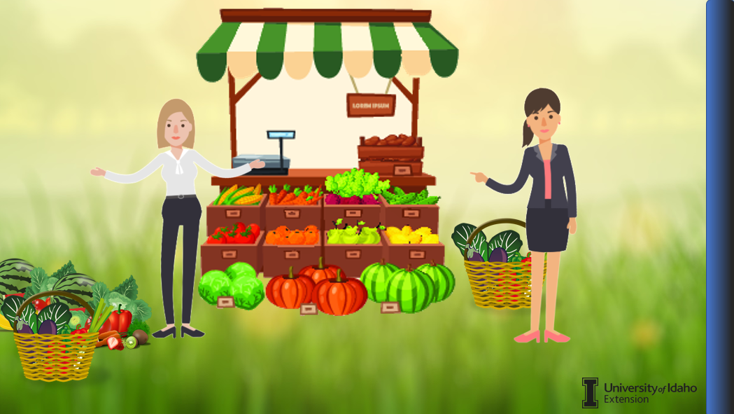
Carmen’s Business
Script:
“Hi Carmen. How is your business going?”
“Hi. Well my garden has been very productive which is great. However, my roadside vegetable stand is not doing very well! I generally sell to friends and family along with a few people who happen to drive by. I’m not on a main road so there is not a lot of traffic. I need to sell more of my produce while it is fresh.”
“Have you considered adding another location to reach more customers? How about relocating your vegetable stand or selling at the local farmers market?”
”I do have a friend who has offered to let me place my stand on their property. That might be a better location.”
Screen Text:
Buttons: Standard Navigation
Fonts: Arial
Video/Images: Animated narrator and Carmen
Notes:
Script: NEEDED

Slide 10
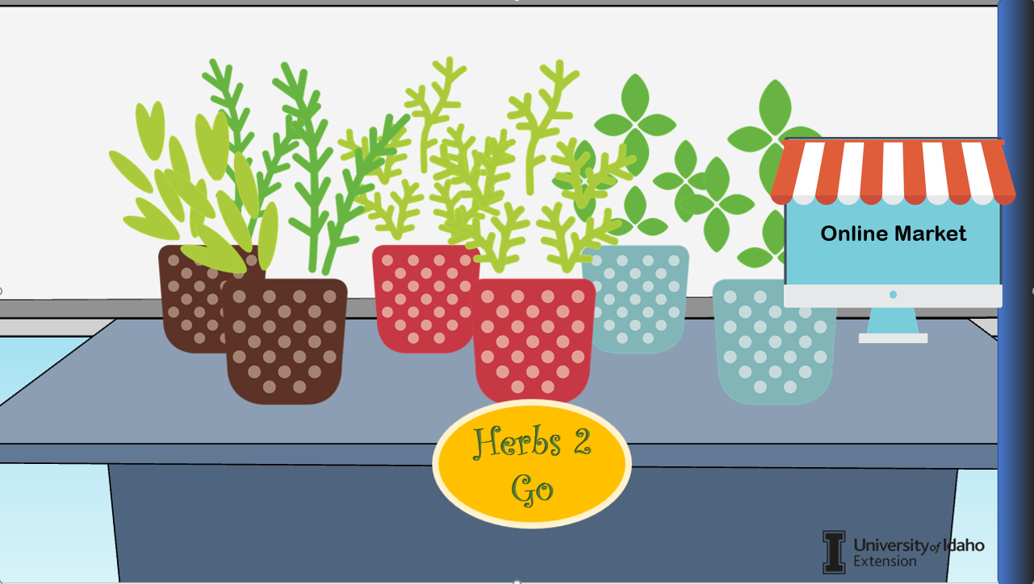
Online Store
Script:
“This year I am going to try selling herbs as well as my canned goods through the winter. I can easily grow the herbs inside and sell them dried or as living herb plants.”
“Customers are often willing to purchase homemade food items versus store-bought. You could even sell them at bazaars during the off-season. So far, your market is local, but you could sell your products online or on social media. This would allow you to reach more customers and expand your market.”
“I hadn’t considered that but that would be a great idea! I will need to lookup more information on how to market and sell online.”
Where will they purchase Vicky’s items? Vicky is selling her produce from her vegetable stand but is considering moving the location of her vegetable stand, so she can reach more customers. During the off-season she is going to develop an online business to reach customers that way.
Screen Text:
Buttons: Standard Navigation
Fonts: Arial
Video/Images:
Notes:
Script: NEEDED

Slide 11
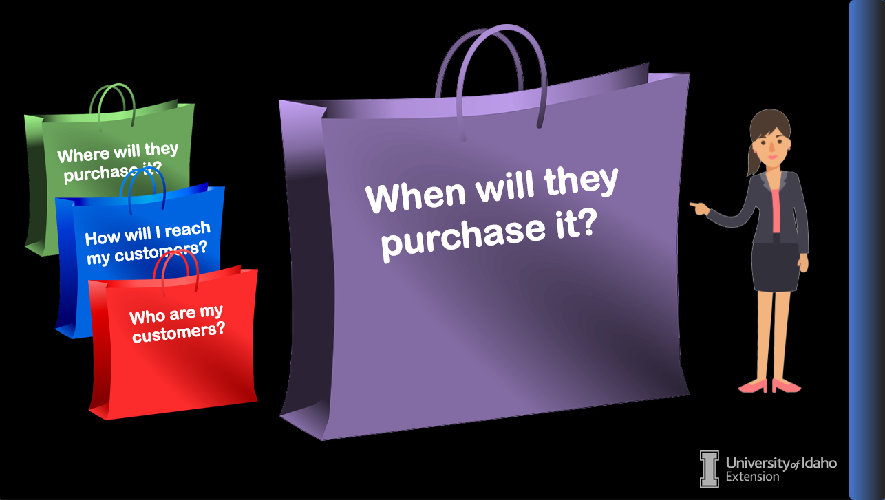
When will they buy it?
Script: When will customers purchase your product or service? Some businesses are seasonal or limited to specific times of the year. It could be items or services that are only purchased seasonally or for special occasions. A seasonal business has a limited amount of time to generate a profit that must last throughout the offseason. Business owners with seasonal businesses often find ways to develop a related activity that will expand their clientele.
Carmen’s vegetable stand is limited to the growing season. However, she is finding ways to preserve her plants and produce so they can be sold online.
Let’s look in on Joe and how his seasonal service business is going.
Screen Text:
Buttons: Standard Navigation
Fonts: Arial
Video / Images: Animated Narrator

Slide 12
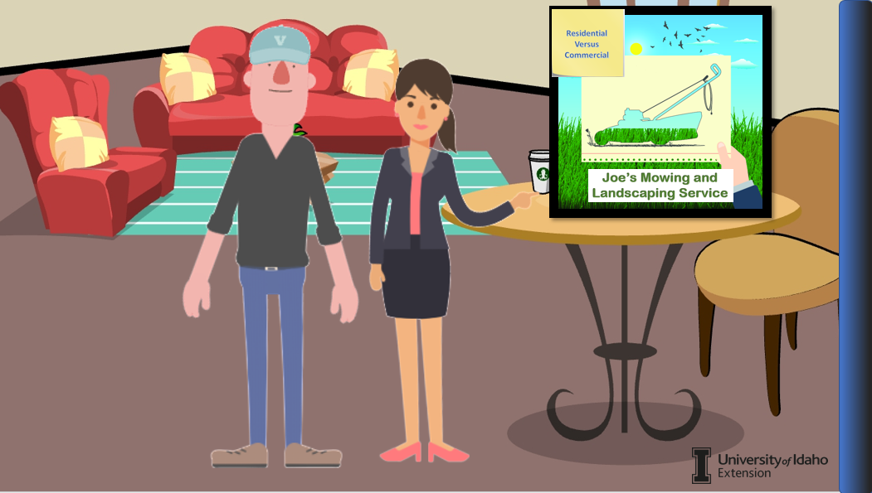
Joe’s Business
Script:
“Hi Joe. We have been looking at the market for different businesses. What does your market look like?”
“During the summer season I have an endless number of clients. The grass is always growing, so customers in need of mowing and trimming are easy to find. However, my business only operates as long as the grass is growing. The offseason is much longer than the season. I would like to start working in the landscaping field and gain some commercial customers. ”
“Most commercial accounts have a year around contract which would also help during the offseason. They usually need lawncare, landscaping, fall clean up, sprinkler maintenance and snow removal. I need to learn how to create a bid or cost proposal so I can compete for the commercial contracts.”
“I can see how offering a variety of services year- round can benefit your business and expand your market.”
Joe’s working season is limited, so he must find ways to expand into another needed service. Picking up accounts that require assistance year around will be very helpful to Joel’s business. To gain commercial customers it is often necessary to learn how to write a competitive bid or proposal. Module # will provide the steps required for creating a bid or proposal.
Buttons: Standard Navigation
Fonts: Arial
Screen Text:
Video/Images: Animated narrator and Joe
Notes:
Script: NEEDED

Slide 13
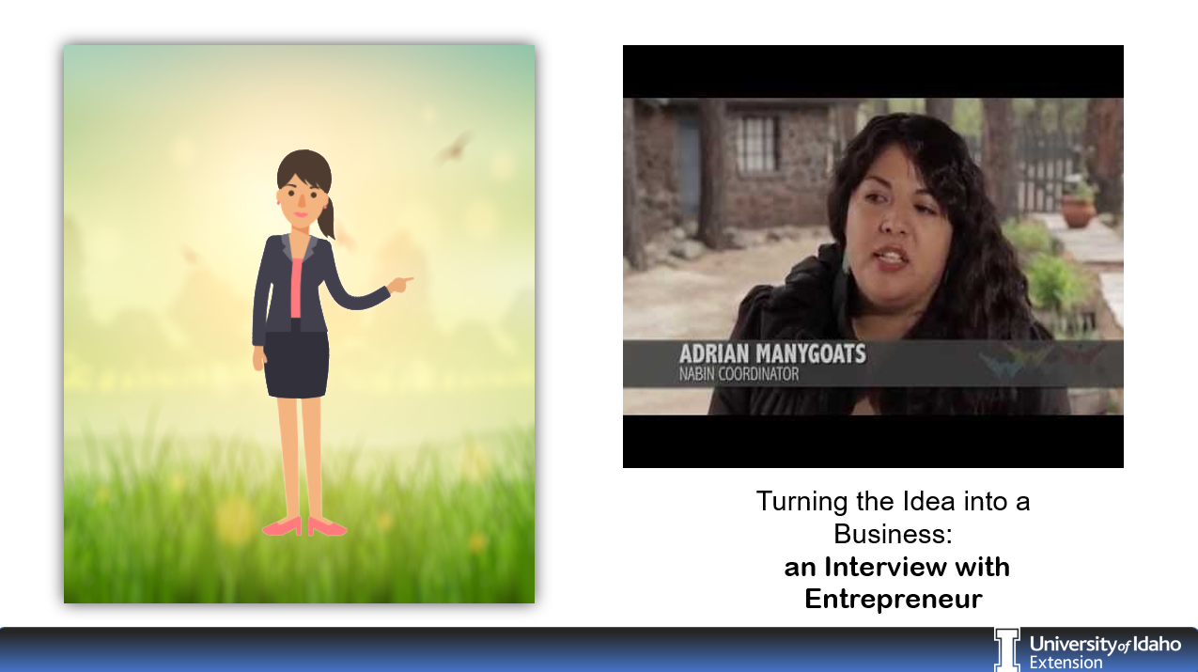
Interview with Entrepreneur
Script: Let’s take a minute to ask a successful entrepreneur how they identified and expanded their market?
Screen Text: Interview with an Entrepreneur about identifying your market.
Buttons: Standard Navigation
Fonts: Arial
Video / Images: Video attached

Slide 14
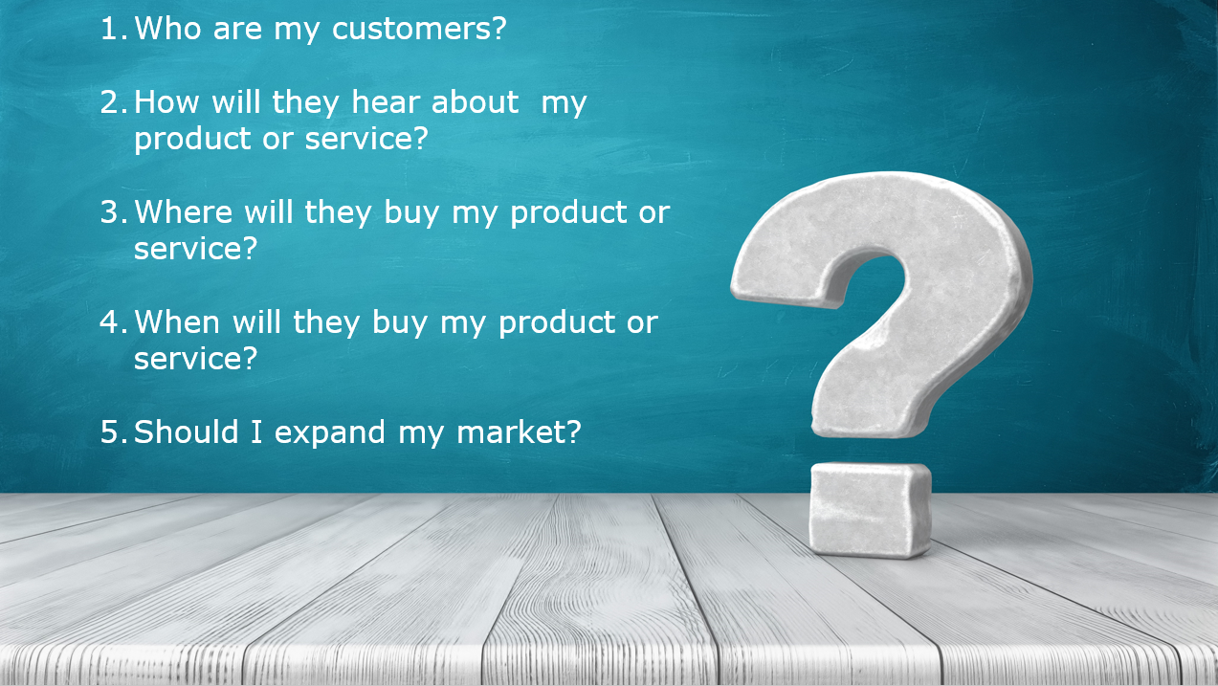
Conclusion
Script: : Defining your market assists you in identifying and reaching your customers. By knowing your market, you can find ways to grow and expand your customer base. Take a few minutes to answer the following questions and apply what you have learning to your own business venture.
Screen Text:
Buttons: Standard Navigation
Fonts: Arial
Video / Images: Questions appear as they are read.

